Slide 1


Slide 2
Revision of Fundamentals
Linear Regression
Logistic Regression
Clustering
Tree based models
Model Selection

Slide 3
Revision of Fundamentals: Linear Regression
Linear regression was developed in the field of statistics and is studied as a model for understanding the relationship between input and output numerical variables, but has been borrowed by machine learning. It is both a statistical algorithm and a machine learning algorithm.
Linear regression is a linear model, e.g. a model that assumes a linear relationship between the input variables (x) and the single output variable (y). More specifically, that y can be calculated from a linear combination of the input variables (x)
In a simple regression problem (a single x and a single y), the form of the model would be:
y = B0 + B1*x
Multiple Techniques
Simple Linear Regression, Ordinary Least Squares, Gradient Descent, Regularization

Slide 4
Revision of Fundamentals: Logistic Regression
Logistic Regression is used when the dependent variable(target) is categorical.
Types of Logistic Regression
Binary Logistic Regression
Multinomial Logistic Regression
Ordinal Logistic Regression
For Interviews (Concepts)
Cost Function
Gradient Descent

Slide 5
Revision of Fundamentals: Clustering
Clustering is a Machine Learning technique that involves the grouping of data points. Given a set of data points, we can use a clustering algorithm to classify each data point into a specific group
Most used Clustering Algorithms
K-Means Clustering
Mean-Shift Clustering
Density-Based Spatial Clustering (DBSCAN)
Gaussian Mixture Models (GMM) based Clustering, Expectation–Maximization (EM)
Hierarchical Clustering

Slide 6
Revision of Fundamentals: Tree Based Models
Tree-based models use a series of if-then rules to generate predictions from one or more decision trees. All tree-based models can be used for either regression (predicting numerical values) or classification (predicting categorical values).
Decision tree models, which are the foundation of all tree-based models.
Random forest models, an “ensemble” method which builds many decision trees in parallel.
Gradient boosting models, an “ensemble” method which builds many decision trees sequentially.
Concept of Bagging and Boosting

Slide 7
Hyperparameter Tuning – WHY?
Let’s come back to Decision Trees Again!
Decision tree is a widely-used supervised learning algorithm which is suitable for both classification and regression tasks. Decision trees serve as building blocks for some prominent ensemble learning algorithms such as random forests, GBDT, and XGBOOST
Some of the features that make them highly efficient:
Easy to understand and interpret
Can handle both numerical and categorical data
Requires little or no preprocessing such as normalization or dummy encoding
Decision trees are prone to overfitting. They can easily become over-complex which prevents them from generalizing well to the structure in the dataset, Thus we tune Hyperparameters
Hyperparameters also define important properties such as its complexity or how fast it should learn

Slide 8
Hyperparameter Tuning – WHY? (contd.)
Some examples of model hyperparameters include:
The penalty in Logistic Regression Classifier i.e. L1 or L2 regularization
The learning rate for training a neural network.
The C and sigma hyperparameters for support vector machines.
The k in k-nearest neighbors.
Models can have many hyperparameters and finding the best combination of parameters can be treated as a search problem. Two best (industry wide) strategies for Hyperparameter tuning are:
GridSearchCV
RandomizedSearchCV

Slide 9
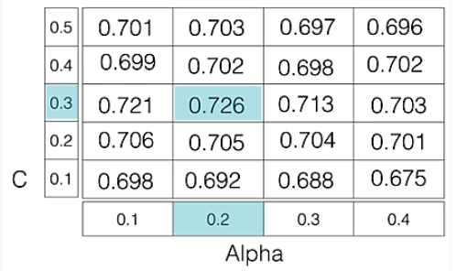
Hyperparameter Selection – HOW? (contd.)
GridSearchCV
This ML model is evaluated for a range of hyperparameter values. This approach is called GridSearchCV, because it searches for best set of hyperparameters from a grid of hyperparameters values
For example, if we want to set two hyperparameters C and Alpha of Logistic Regression Classifier model, with different set of values. The gridsearch technique will construct many versions of the model with all possible combinations of hyperparameters, and will return the best one.
Drawback : GridSearchCV will go through all the intermediate combinations of hyperparameters which makes grid search computationally very expensive.
As in the image, for C = [0.1, 0.2, 0.3, 0.4, 0.5] and Alpha = [0.1, 0.2, 0.3, 0.4].
For a combination C=0.3 and Alpha=0.2, performance score comes out to be 0.726(Highest), therefore it is selected.
Code Snippet in slide notes
Notes:
# Necessary imports
from sklearn.linear_model import LogisticRegression
from sklearn.model_selection import GridSearchCV
# Creating the hyperparameter grid
c_space = np.logspace(-5, 8, 15)
param_grid = {'C': c_space}
# Instantiating logistic regression classifier
logreg = LogisticRegression()
# Instantiating the GridSearchCV object
logreg_cv = GridSearchCV(logreg, param_grid, cv = 5)
logreg_cv.fit(X, y)
# Print the tuned parameters and score
print("Tuned Logistic Regression Parameters: {}".format(logreg_cv.best_params_))
print("Best score is {}".format(logreg_cv.best_score_))
Output:
Tuned Logistic Regression Parameters: {‘C’: 3.7275937203149381} Best score is 0.7708333333333334

Slide 10
Hyperparameter Selection – HOW? (contd.)
RandomizedSearchCV
This algorithm solves the drawbacks of GridSearchCV, as it goes through only a fixed number of hyperparameter settings. It moves within the grid in random fashion to find the best set hyperparameters. This approach reduces unnecessary computation.
Output:
Tuned Decision Tree Parameters: {‘min_samples_leaf’: 5, ‘max_depth’: 3, ‘max_features’: 5, ‘criterion’: ‘gini’} Best score is 0.7265625
Notes:
# Necessary imports
from scipy.stats import randint
from sklearn.tree import DecisionTreeClassifier
from sklearn.model_selection import RandomizedSearchCV
# Creating the hyperparameter grid
param_dist = {"max_depth": [3, None],
"max_features": randint(1, 9),
"min_samples_leaf": randint(1, 9),
"criterion": ["gini", "entropy"]}
# Instantiating Decision Tree classifier
tree = DecisionTreeClassifier()
# Instantiating RandomizedSearchCV object
tree_cv = RandomizedSearchCV(tree, param_dist, cv = 5)
tree_cv.fit(X, y)
# Print the tuned parameters and score
print("Tuned Decision Tree Parameters: {}".format(tree_cv.best_params_))
print("Best score is {}".format(tree_cv.best_score_))
Output:
Tuned Decision Tree Parameters: {‘min_samples_leaf’: 5, ‘max_depth’: 3, ‘max_features’: 5, ‘criterion’: ‘gini’} Best score is 0.7265625

Slide 11
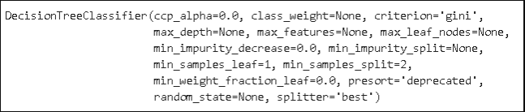
Hyperparameters in Decision Trees via Implementation
import numpy as np
import pandas as pd
from sklearn.datasets import load_wine
X, y = load_wine(return_X_y = True)
from sklearn import tree
clf = tree.DecisionTreeClassifier()
clf.fit(X, y)
import matplotlib.pyplot as plt
%matplotlib inline
plt.figure(figsize=(24,14))
tree.plot_tree(clf, filled=True, fontsize=14)
We will use one of the built-in datasets of scikit-learn. The wine dataset contains 13 features (i.e. columns) on three different wine classes. There are 178 samples (i.e. rows) in the dataset.
Decision tree classifier without any hyperparameter tuning.
All of the hyperparameters are set with the default settings. We can plot our model using plot_tree function
Notes:
# Necessary imports
from scipy.stats import randint
from sklearn.tree import DecisionTreeClassifier
from sklearn.model_selection import RandomizedSearchCV
# Creating the hyperparameter grid
param_dist = {"max_depth": [3, None],
"max_features": randint(1, 9),
"min_samples_leaf": randint(1, 9),
"criterion": ["gini", "entropy"]}
# Instantiating Decision Tree classifier
tree = DecisionTreeClassifier()
# Instantiating RandomizedSearchCV object
tree_cv = RandomizedSearchCV(tree, param_dist, cv = 5)
tree_cv.fit(X, y)
# Print the tuned parameters and score
print("Tuned Decision Tree Parameters: {}".format(tree_cv.best_params_))
print("Best score is {}".format(tree_cv.best_score_))
Output:
Tuned Decision Tree Parameters: {‘min_samples_leaf’: 5, ‘max_depth’: 3, ‘max_features’: 5, ‘criterion’: ‘gini’} Best score is 0.7265625

Slide 12
Hyperparameters in Decision Trees via Implementation
clf = tree.DecisionTreeClassifier(min_impurity_decrease=0.2)
clf.fit(X, y)
plt.figure(figsize=(18,10))
tree.plot_tree(clf, filled=True, fontsize=14)
clf = tree.DecisionTreeClassifier(max_depth=3)
clf.fit(X, y)
plt.figure(figsize=(20,10))
tree.plot_tree(clf, filled=True, fontsize=14)
clf = tree.DecisionTreeClassifier(max_depth=3,min_samples_leaf=3)
clf.fit(X, y)
plt.figure(figsize=(20,10))
tree.plot_tree(clf, filled=True, fontsize=14)
clf = tree.DecisionTreeClassifier(max_leaf_nodes=5)
clf.fit(X, y)
plt.figure(figsize=(20,10))
tree.plot_tree(clf, filled=True, fontsize=14)
When the algorithm performs a split, the main goal is to decrease impurity as much as possible. The more the impurity decreases, the more informative power that split gains. As the tree gets deeper, the amount of impurity decrease becomes lower. We can use this to prevent the tree from doing further splits. Hyperparameter name for this is : min_impurity_decrease. It will return a smaller tree as output when values are changed from default value of 0
Min_impurity_split parameter can be used to control the tree based on impurity values. It sets a threshold on gini. For instance, if min_impurity_split is set to 0.3, a node needs to have a gini value that is more then 0.3 to be further splitted. Another hyperparameter to control the depth of a tree is max_depth. It does not make any calculations regarding impurity or sample ratio. The model stops splitting when max_depth is reached.
min_samples_leaf, It indicates the minimum number of samples required to be at a leaf node. We need to be careful when using hyperparameters together.
We can also limit the number of leaf nodes using max_leaf_nodes parameter which grows the tree in best-first fashion until max_leaf_nodes reached. The best split is decided based on impurity decrease.
max_features which is the number of features to consider when looking for the best split

Slide 13
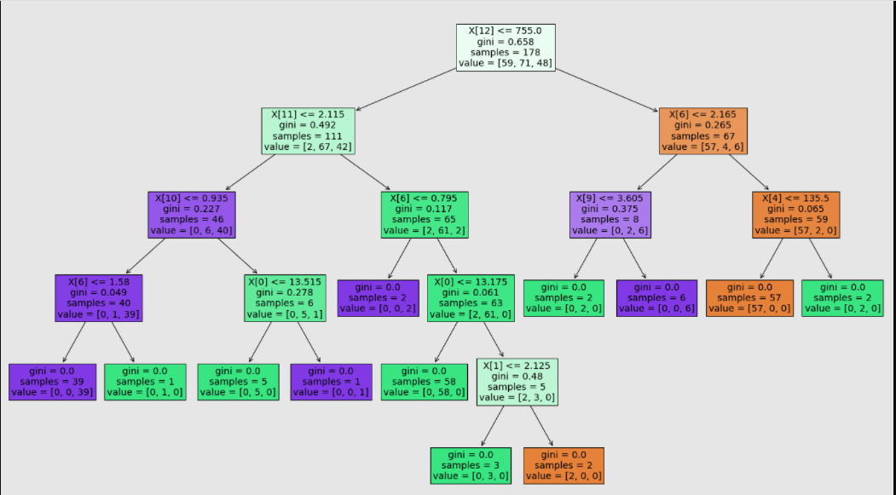
Hyperparameters in Decision Trees via Implementation
The model keeps splitting the nodes until all the nodes are pure (i.e. contain samples from only one class).
In each box:
The first line indicates the name of the feature (i.e. column) Since we did not name the columns, the index of the column is shown
Samples indicates the number of observations (i.e. rows)
Value shows the distribution of these samples according to the target variable.
Gini is a measure of impurity
Gini impurity is a measure of how often a randomly chosen element from the set would be incorrectly labeled if it was randomly labeled according to the distribution of labels in the subset. If you take a look the leaf nodes (the nodes at the end of tree), you will see that gini is equal to zero.
Notes:
Gini Index : For instance, let’s say we have a box with ten balls in it. If all the balls are same color, we have no randomness and impurity is zero. However, if we have 5 blue balls and 5 red balls, impurity is 1. If you take a look the leaf nodes (the nodes at the end of tree), you will see that gini is equal to zero.

Slide 14
Tree Model for Segmentation process
Case : Customer profiling and segmentation : Ecommerce Industry
Approaches:
Logical Business Segments
Age Buckets
Income Buckets
etc
Algorithmic Segments
statistics, data mining, analytics, machine learning, or whatever it's called. More specifically, we can use the classic K-Means Clustering algorithm to learn an optimal set of segments given some set of data
Notes:
import pydotplus
import pandas as pd
from sklearn.tree import DecisionTreeClassifier
from sklearn.tree import export_graphviz
from sklearn.externals.six import StringIO
optimal_clusters = 6
# 6 clusters 6 colors
xcolors = ['red', 'green', 'blue', 'orange', 'purple', 'gray’]
# Chose 6 as the best number of clusters
kmeans_model = (KMeans(n_clusters = optimal_clusters,init='k-means++', n_init = 10 ,max_iter=300, tol=0.0001, random_state= 111 , algorithm='elkan') )
kmeans_model.fit(X1)
cdf['pred_cluster_kmeans'] = kmeans_model.labels_
centroids = kmeans_model.cluster_centers_
display(pd.DataFrame(cdf['pred_cluster_kmeans'].value_counts(normalize=True)))
clf = DecisionTreeClassifier()
# Train Decision Tree Classifer
clf = clf.fit(X1, cdf['pred_cluster_kmeans’])
# Predict the response for test dataset
cdf['pred_class_dtree'] = clf.predict(X1)
display(pd.crosstab(cdf['pred_cluster_kmeans'], cdf['pred_class_dtree']))
dot_data = StringIO()
export_graphviz(
decision_tree=clf,
out_file=dot_data,
filled=True,
rounded=False,
impurity=False,
special_characters=True,
feature_names=xcol_labels,
class_names=cdf['pred_cluster_kmeans'].unique().astype(str).tolist(), )
graph = pydotplus.graph_from_dot_data(dot_data.getvalue())
graph.write_png("./decisiontree.png")

Slide 15
Choosing the right model
Linear Regression is used to predict continuous outputs where there is a linear relationship between the features of the dataset and the output variable. It is used for regression problems where you are trying to predict something with infinite possible answers such as the price of a house.
Decision trees can be used for either classification or regression problems and are useful for complex datasets. They work by splitting the dataset, in a tree-like structure, into smaller and smaller subsets and then make predictions based on what subset a new example would fall into.
When to use which?
Linear regression is appropriate for datasets where there is a linear relationship between the features and the output variable. Polynomial regression can also be used when there is a non-linear relationship between the features and the output. Linear regression can be prone to underfitting the data. Feature scaling is not generally required in linear, multiple or polynomial regression
Alternatives to Linear Regression:
Polynomial regression
Decision tree regression
Random forest regression
Support vector regression

Slide 16
Choosing the right model (contd.)
Decision Trees for Regression:
In the case of regression, decision trees learn by splitting the training examples in a way such that the sum of squared residuals is minimized. It then predicts the output value by taking the average of all of the examples that fall into a certain leaf on the decision tree and using that as the output prediction.
Decision Trees for Classification:
For classification, decision trees learn by splitting the training examples so that it can divide the data into subsets that separate the categories the data points fall into as much as possible. They then make output predictions based on the most common category in the subset that the new example would fall into
When to use Decision Trees?
Decision trees are useful when there are complex relationships between the features and the output variables. They also work well compared to other algorithms when there are missing features, when there is a mix of categorical and numerical features and when there is a big difference in the scale of features.
Alternatives to Decision Trees
For Classification: Random Forest, SVM, K-NN, Logistic Regression, Naïve Bayes, Neural Networks
For Regression: Linear Regression, Polynomial regression, Support vector regression, Random forest regression

Slide 17
Linear Regression vs Decision Tree vs Clustering use cases
Linear Regression Use Cases
Decision Tree Use Cases
Clustering Use Cases
Sales of a product; pricing, performance, and risk parameters
Generating insights on consumer behavior, profitability, and other business factors
Evaluation of trends; making estimates, and forecasts
Determining marketing effectiveness, pricing, and promotions on sales of a product
Assessment of risk in financial services and insurance domain
Studying engine performance from test data in automobiles
Calculating causal relationships between parameters in biological systems
Conducting market research studies and customer survey results analysis
Astronomical data analysis
Predicting house prices with the increase in sizes of houses
Building knowledge management platforms for customer service that improve first call resolution, average handling time, and customer satisfaction rates
In finance, forecasting future outcomes and assigning probabilities to those outcomes
Binomial option pricing predictions and real option analysis
Customer’s willingness to purchase a given product in a given setting, i.e. offline and online both
Product planning; for example, Gerber Products, Inc. used decision trees to decide whether to continue planning PVC for manufacturing toys or not
General business decision-making
Loan approval
Customer segmentation
Classification of species by using their physical dimensions
Product categorization
Movie recommendations
Identifying locations of putting cellular towers in a particular region
Effective police enforcement
Placing emergency wards considering the factor of maximum accident-prone areas in a region
Clustering genes
Impact of number of attributes

Slide 18
Doubt Resolution
What is the lifecycle of the data science project?
What is the Differentiate between Univariate, Bivariate, and Multivariate analysis?
Mention the two kinds of target variables for predictive modeling.
How to perform univariate analysis for numerical and categorical variables?
How to perform Bivariate analysis for Numerical-numerical, Categorical-Categorical, and Numerical-Categorical variables?
During the data preprocessing step, how should one treat missing/null values? How will you deal with them?
What is an outlier and how to identify them?
How can the data be normalized?
Link to AV Article for Answers to all questions.

Slide 19
Questions?

Slide 20
Thank You!

